Slide 1
6. Orthogonality and least square

Slide 2
6. Inner product, length and orthogonality

Slide 3
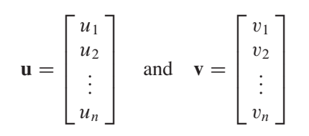
The number uT v is called the inner product of u and v, and often it is written as u.v (dot product)

Slide 4
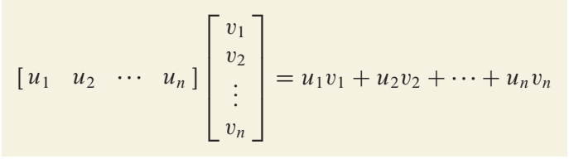
The number uT v is called the inner product of u and v, and often it is written as u.v (dot product)

Slide 5
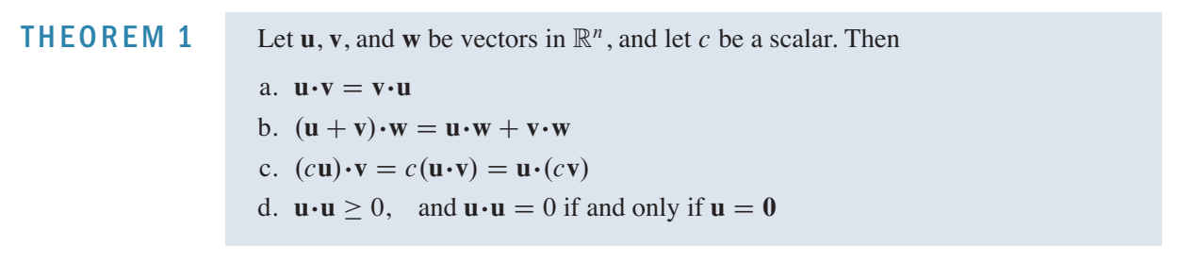


Slide 6

Length of a vector

Slide 7

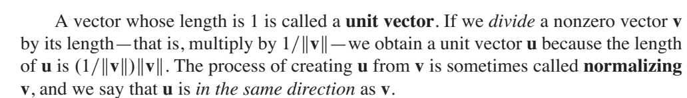
Length of a vector

Slide 9
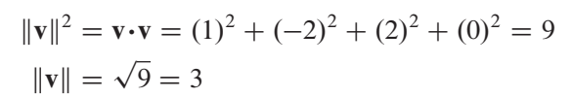
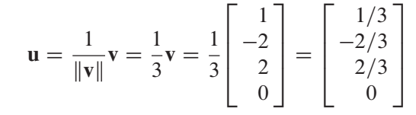
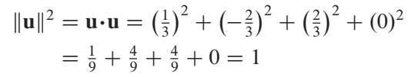

Slide 10
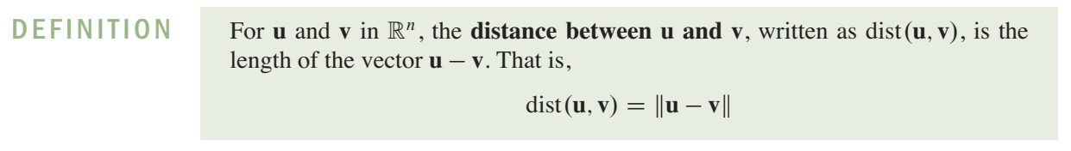

Slide 11
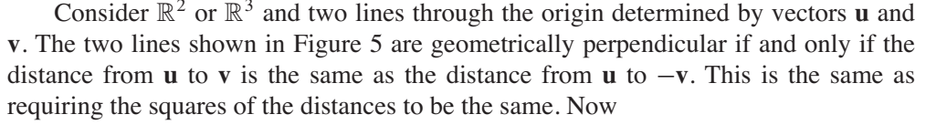
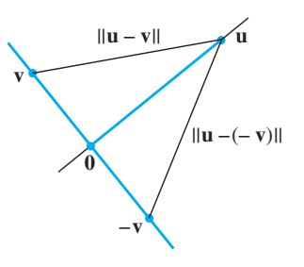
Orthogonal vectors

Slide 12
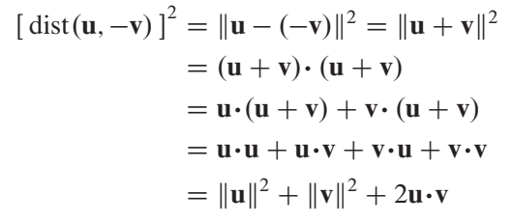


Orthogonal vectors

Slide 13


Slide 15


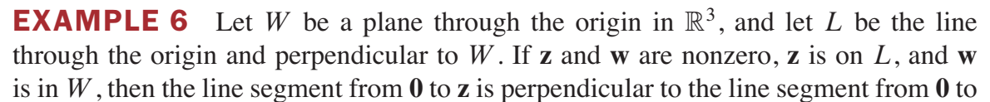

Slide 16
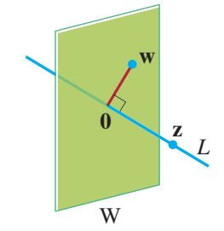


Slide 17
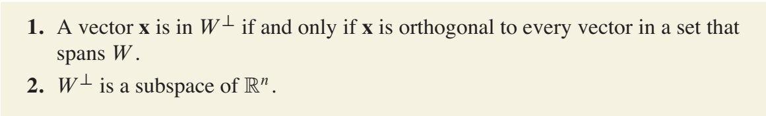

Slide 18
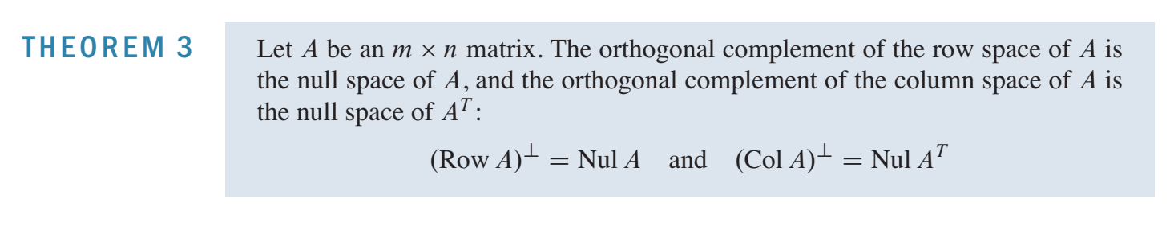

Slide 19
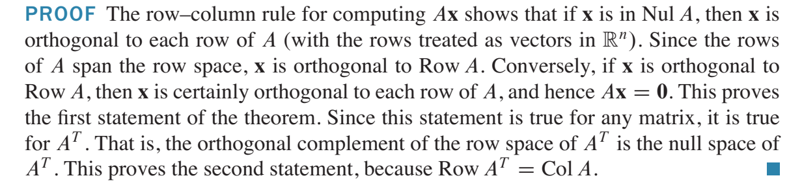

Slide 21
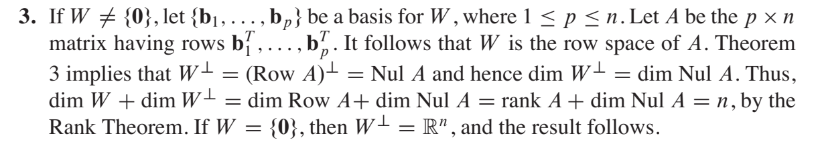

Slide 22
Orthogonal sets

Slide 24
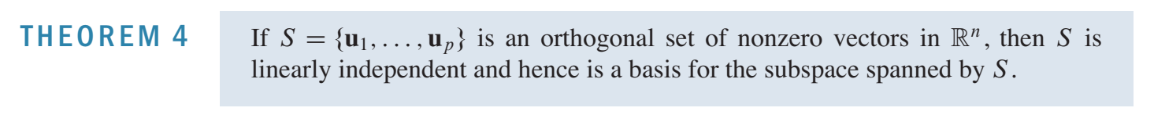

Slide 25
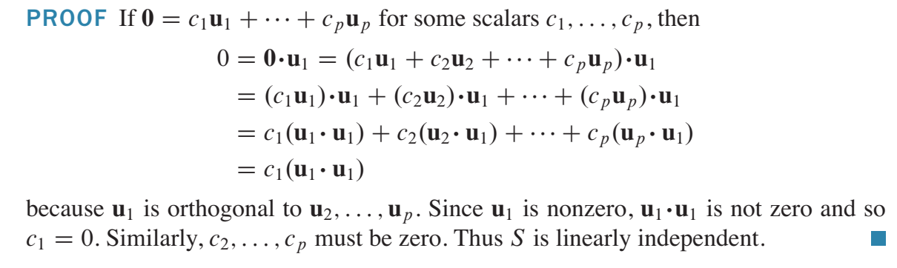

Slide 26


Slide 27
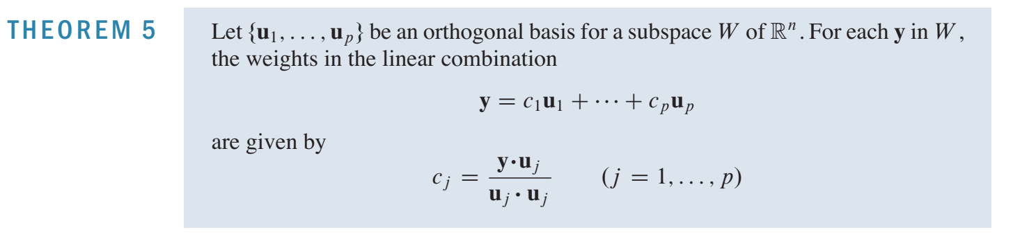

Slide 28
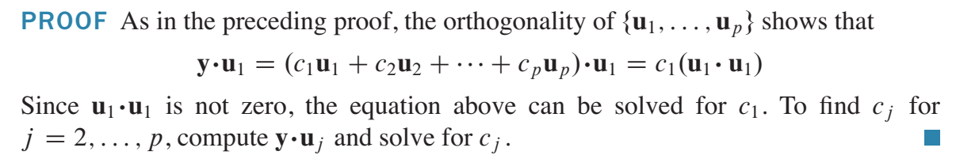

Slide 29
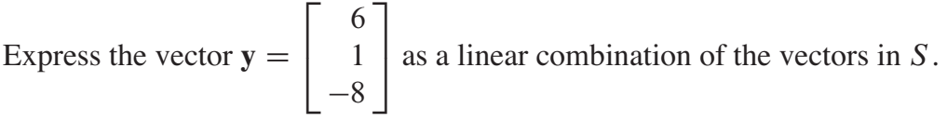
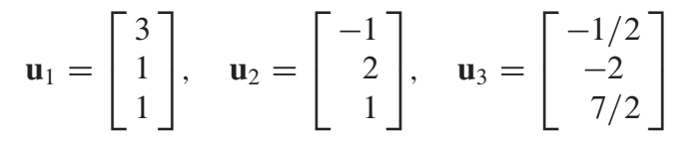

Slide 30
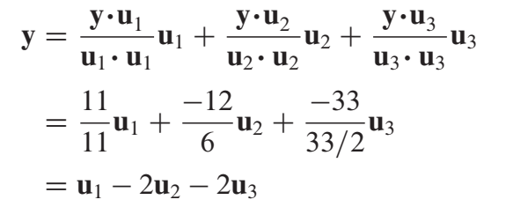

Slide 31
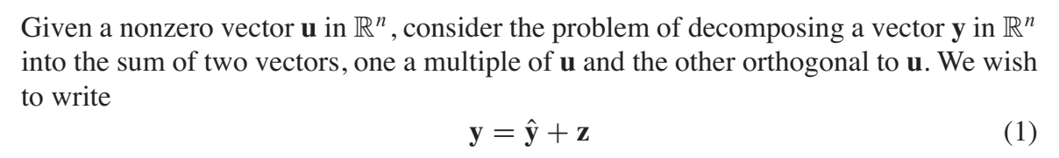
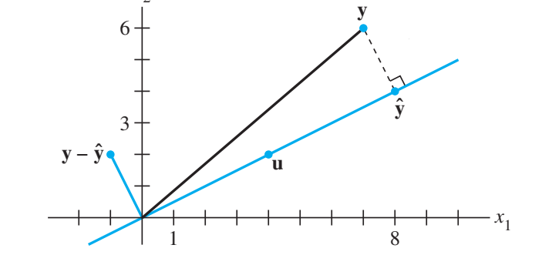
Orthogonal projection

Slide 32


Orthogonal projection

Slide 33

Orthogonal projection

Slide 34
subspace L spanned by u

Slide 35
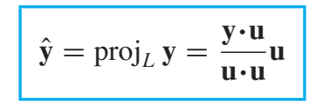
subspace L spanned by u
Sometimes yO is denoted by projL y and is called the orthogonal projection of y onto L. That is,

Slide 36
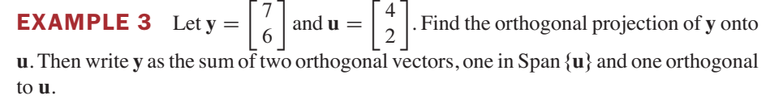

Slide 37


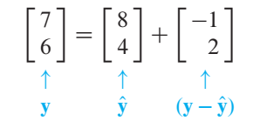

Slide 38

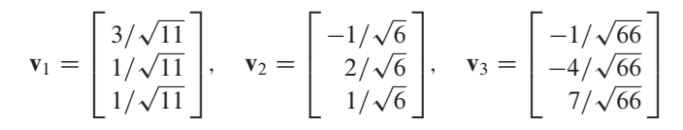
Orthonormal Sets

Slide 40

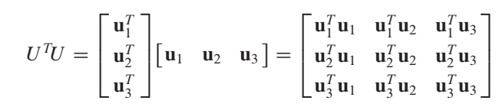

Slide 41
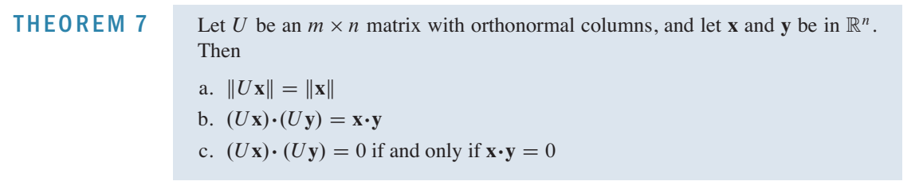

Slide 42
It is easy to see that any square matrix with orthonormal columns is an orthogonal matrix.

Slide 43
6.3. orthogonal projections

Slide 44

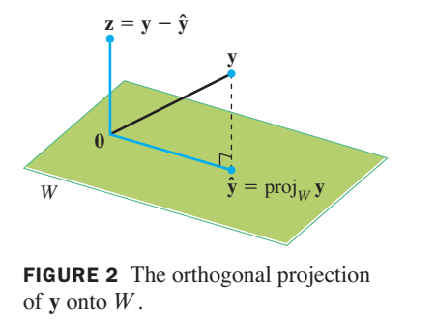
The orthogonal projection of a point in R2 onto a line through the origin has an important analogue in Rn

Slide 45
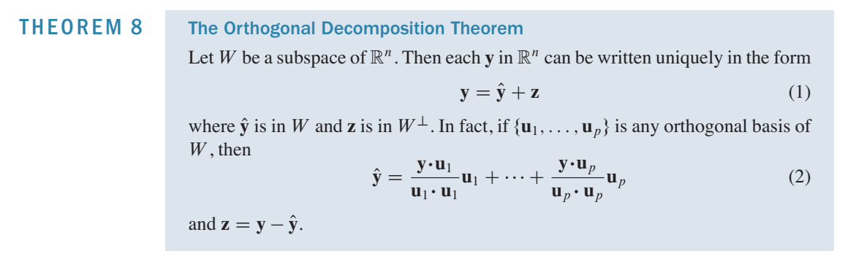

Slide 46
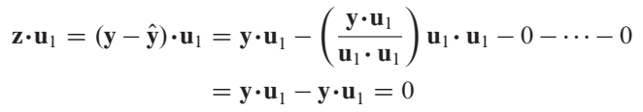


Slide 47



Slide 48
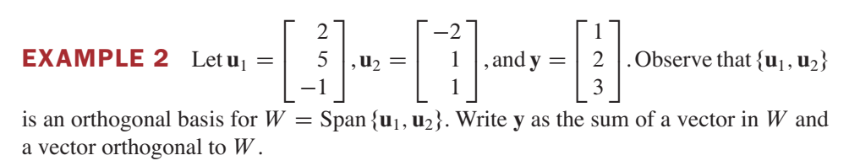

Slide 49
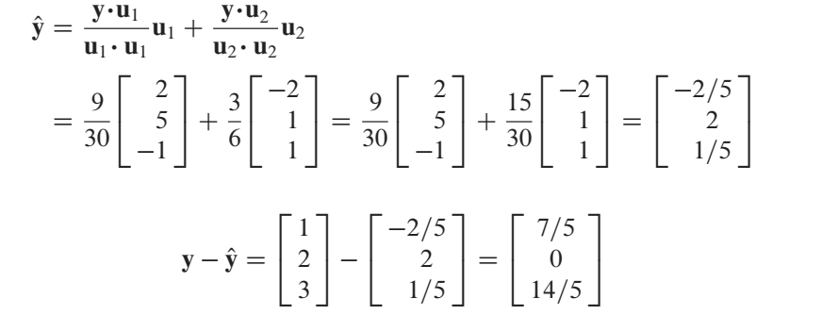
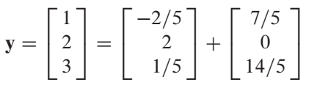

Slide 50
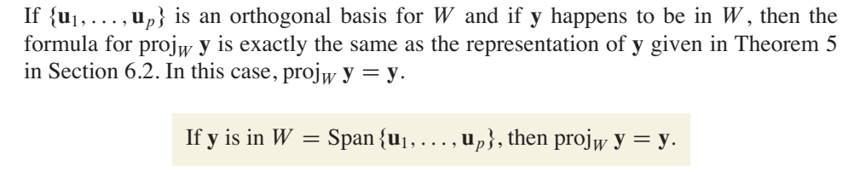

Slide 51
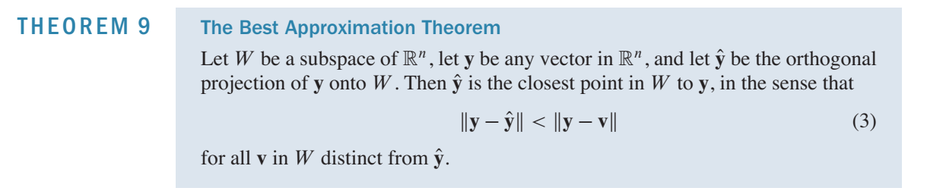
Min error

Slide 52
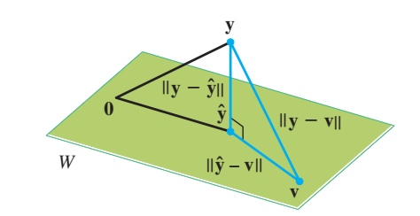


Slide 53



Slide 54
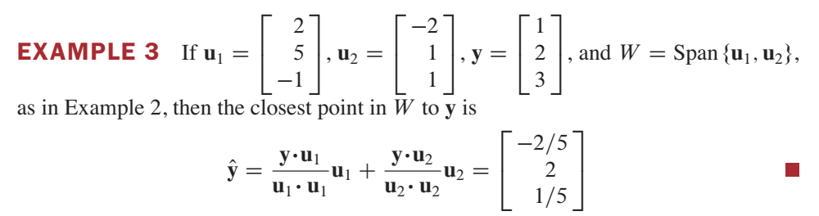

Slide 55
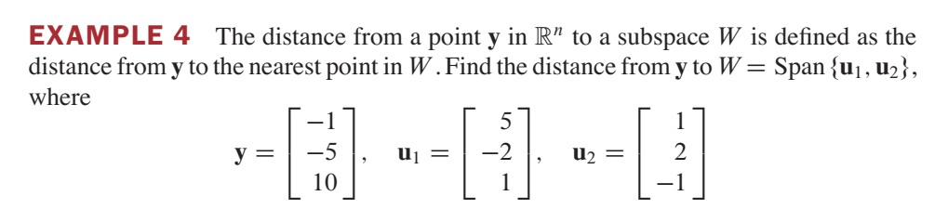

Slide 56
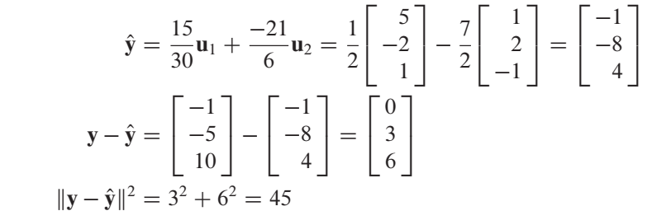

Slide 57
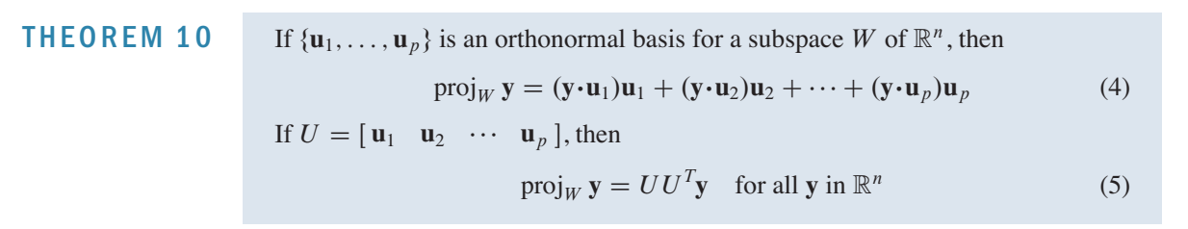

Slide 58
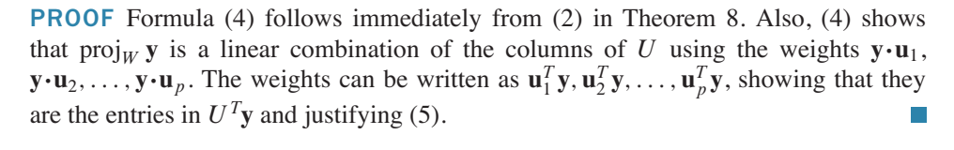

Slide 59
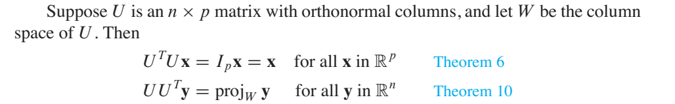
How find orthonormal basis for subspaces

Slide 60
Gram-Schmidt process

Slide 61
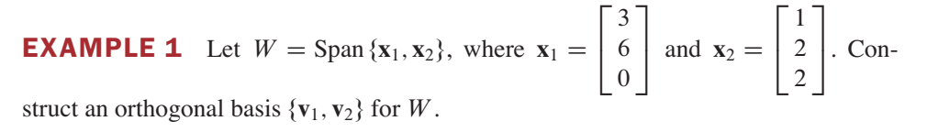
The Gram–Schmidt process is a simple algorithm for producing an orthogonal or orthonormal basis for any nonzero subspace of Rn

Slide 62
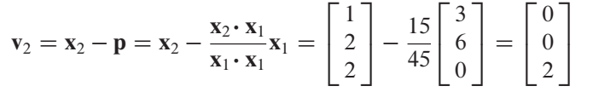
The Gram–Schmidt process is a simple algorithm for producing an orthogonal or orthonormal basis for any nonzero subspace of Rn

Slide 63
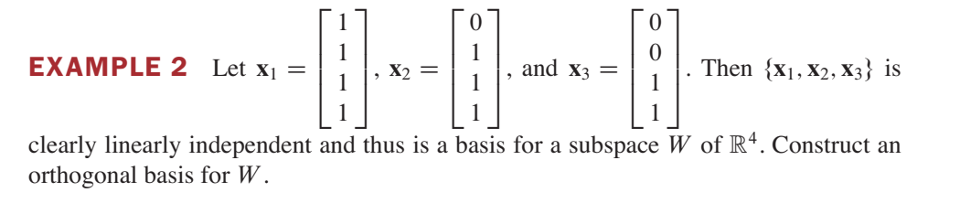

Slide 64


Slide 65



Slide 66


Slide 67



Slide 68


Slide 69




Slide 70


